Slide 1


1
SWE - 4404
NESTUP BD
A Smart Relocation Support
Presented by :
AHNAF SHAHRIAR PIAS ( 220042146 )
MD. SAMEUR RAHMAN ( 220042144 )
IRFAN SHAFEE ( 220042164 )
=============================================

Slide 2





2
PROJECT OVERVIEW
One-stop Platform for students relocating for exams.
Services:
housing, transport, meals, stationery
Locals provide gigs,
Students receive service
Ensures affordable,
and stress-free
short-term relocation

Slide 3



3
MOTIVATION BEHIND THE PROJECT
Students struggle during exam travel.
No unified platform exists
Connects students with local service providers.
Solves a common, nationwide problem
Rangpur
Sylhet
Rajshahi
Dhaka
Chittagong

Slide 4
4
USER ROLES & INTERACTION FLOW
SERVICE SEEKER
Books
&
Pays
Searches
Service
Receives
Service
Rates Experience
SERVICE
PROVIDER
Posts
Gig
Manages Requests
Delivers Service
Builds Reputation

Slide 5



KEY
FEATURES
Authentication
Search & Filter
Posting Service
Booking Service
5

Slide 6





KEY
FEATURES
Verified/Hygene
Badge
Rating & Review
Future Scope
6
Transport
Meals

Slide 7









7
Tools & Technologies
React js
FRONTEND
BACKEND
VERSION CONTROL
DATABASE

Slide 8
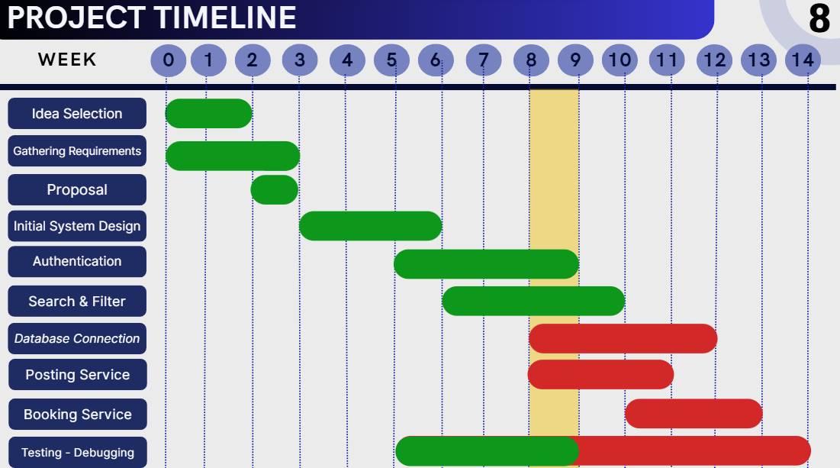

Slide 9
9
== DEMO ==

Slide 10
10
== THANK YOU ==

